Slide 1
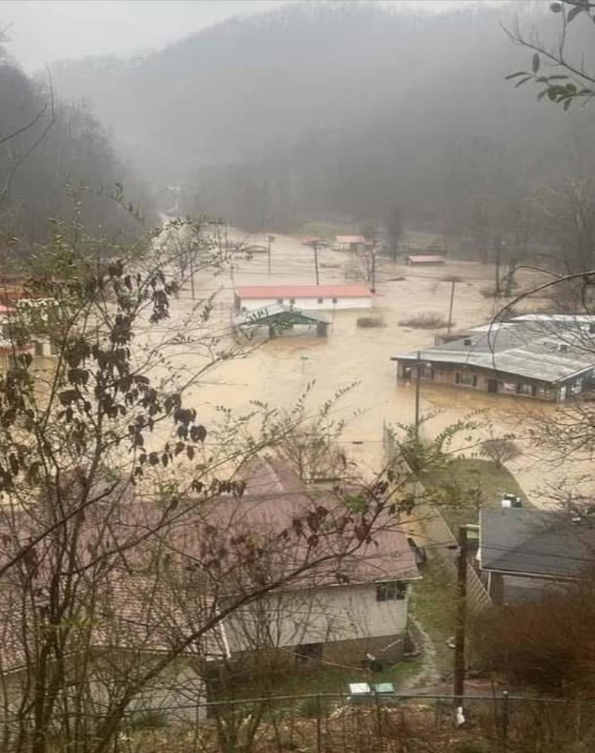
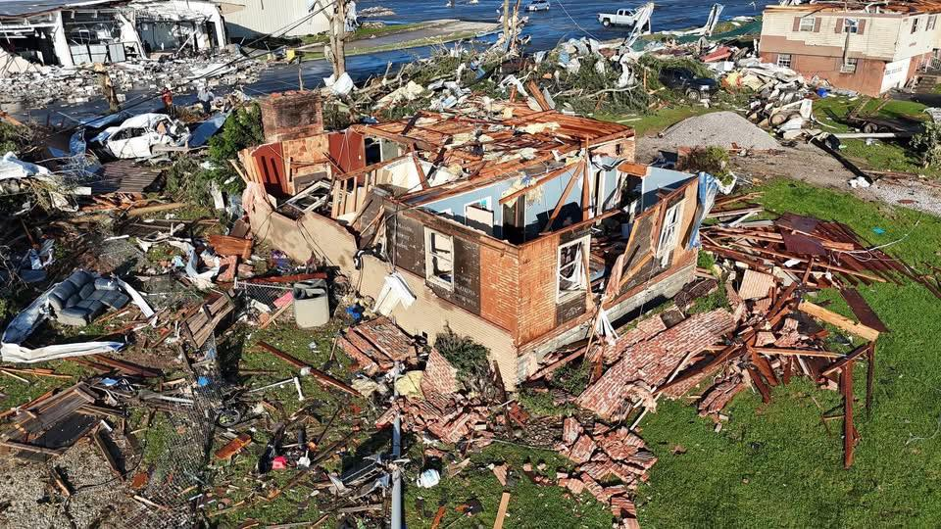
February 3, 2026
The Cost of Disasters
to State and Local Economies.
Director Eric Gibson
Eric.Gibson@ky.gov
Notes:
Thank you for having us today. We are passionate about keeping the residents of the Commonwealth safe and what we can do to prepare, quickly respond, and recover from disasters.

Slide 2
Kentucky Disaster Facts
Three types of disaster assistance, Public Assistance, Individual Assistance, Hazard Mitigation
Seven of the top ten most declared counties in the US
Kentucky PA Threshold 8.7 million based on state population x $1.94
County by county PA threshold based on population x $4.86
  Fayette $1,567,690.20 Johnson $110,224.80
Individual Assistance, no numerical formula for consideration
Hazard Mitigation, Enhanced Status, 20% of PA declaration value at 1 year. Under appeal for last two events.

Slide 3
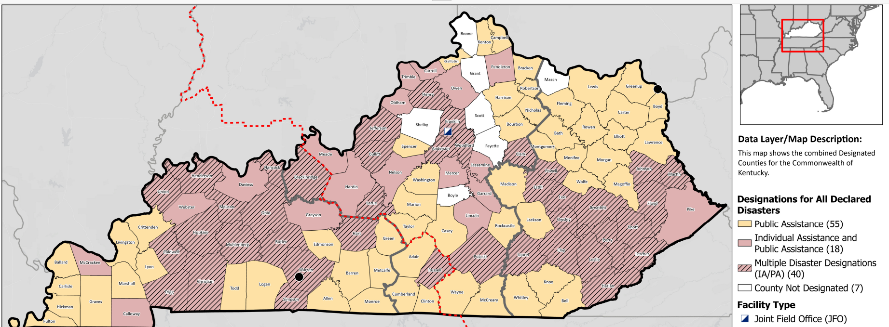
KY Declared Counties Federal FY25

Slide 4
Financial Considerations
How disasters have a negative impact on the economy
  Destroys homes, business, and public buildings
    Relocate, close, inventory loss, schools
    Shrinks tax rolls
  Interrupts normal business and local government
    Loss of regular customers, official plan out the window
  Expensive repairs to infrastructure, delayed reimbursement
    Bridges, roads, buildings, utilities, schools/ long process to be whole

Slide 5
Financial Considerations
How disasters have a positive impact on the economy.
  Rebuilding homes and businesses
    Construction, building materials, bank loans
  Surge of workers into the local area
    FEMA, volunteers, contractors, work crews
  Local government contracts to repair infrastructure
    Asphalt, gravel, concrete, lumber, labor
  Other considerations?
    Tax revenue Up/Down

Slide 6
Disaster Cost Burden/Public Assistance
      Events Estimated Cost
      2026
        January Ice Event $20,000,000
      2025
        January Ice Event Undeclared $ 16,600,000 PA Denied
      February Flooding DR 4860 $300,000,000
      April Flooding DR 4864 $250,000,000 HM Denied
      May Tornado DR 4875 $ 75,000,000 HM Denied
      2024
      April Tornado DR 4782 $ 5,400,000 PA Denied
      May Tornado DR 4804 $ 48,400,000
      Hurricane Helene DR 4848 $ 15,000,000
      Total Impact $730,400,000
Notes:
Beginning April 2, 2024 until now we have had 6 Federally declared disasters, not including 2 Emergency Declarations. 1 hurricane, 3 tornadoes, 2 floods and ice storm that is currently pending appeal. We have additionally have had many severe weather outbreaks that did not result in a presidential declaration. Tornadoes, flooding, landslides, hail and snow.
All disaster response begins local and ends local. The states role is to support and be there ready to send when needed. Our Federal partners are there to support the states efforts when needed.
KMAS, Statewide Mutual Aid, USAR TF-1, NWS meteorologist deployed inside EOC during activations, EMAC in and out, contractor support,
Buyouts with Haz Mit. 530.
Prepare, Respond, Recover, Mitigate.

Slide 7
Local Economy: Pike Co Example
Cost Strap to State and Local Economies
Pike County Kentucky, population 55,500. Annual budget $24 m
  Three major disasters since 2022
  Estimated Damages $95,499,768 across the events
  Total PA reimbursed to Pike County from FEMA via KYEM
    Paid $29,666,618.37
    Balance Due $53,418,180.00
  Cost Share
    FEMA 75% ---- $71,624,826 ( Discussion of this percentage moving lower)
    State 12% ---- $11,459,972
    Local 13% ---- $12,414,969
Mitigation
Notes:
In a lookback over the past 15 years KY leads all surrounding states and Florida with 33 declarations. In the 10 year period we are tied with Florida and in the 5 year period we are third with Florida having 21, TN 20, KY 19.
What has changed in the last 5 years is the cost. In the entire period of lookback our cost were 2.3 billion however 2.039 billion occurred in the last 5 years. More severe and more expensive. This change has led to many of the conversations like today that help improve our efforts to be ready, resilient and prepared for the next wave or storms whatever they may be.

Slide 8
Reimbursements
Public Assistance
Hazard Mitigation
Totals
2023-2024 = $312,672,906.05
2024-2025 = $256,442,677.02
2025-Current = $97,175,195.88
2023-2024 - $ 28,241,164.57
2024-2025 - $ 28,298,389.21
2025-Current - $14,492,218.33
2023-2024 - $340,914,070.62
2024-2025 - $284,741,066.23
2025-Current - $111,667,414.21
Grand Total - $737,322,551.06

Slide 9
Individual Assistance Paid in KY 2025: $112M
Assistance paid to individuals who have suffered personal loss
Not included in many declarations. No numerical formula
Pays for items not covered by insurance or lack of insurance
Max benefit $44,800. Not often paid. Average approved claim: $4,000.
  Displacement Assistance, Child Care, Serious Needs such as food, water, clothing
  Home repairs, car, personal bridge or access
  Heavily scrutinized for waste, fraud, and abuse
  NFIP one time benefit without maintaining insurance

Slide 10
Hazard Mitigation
Two types of HM funding in a disaster
  When repairing, entity can build back with better/stronger acceptable method; for example, utility can replace a wooden pole that was broken with a metal
  Can be used for buyouts, generators, storm shelters, flood walls, storm sirens. Major Accomplishments
  600 flooded homes purchased and given to local government
  100 storm shelters built
  100s of generators placed on critical infrastructure.
Research indicates for every $1.00 invested an $8.00 return is realized.

Slide 11

$404M Backlog of Funds from FEMA
Slowed Response to Review Project Obligation, Final Inspections
Policy Changes
Extra Scrutiny

Slide 12
Economic Concerns
Long reimbursement process causes impacted entity to be cash strapped for years after a disaster or forced into financing repairs.
Repetitive Loss entities risk future denials by deferring maintenance money and/or labor that is being shifted to disaster repairs.
Potential changes or elimination of Federal Assistance at current levels would switch more burden to state and local government budgets.

Slide 13
Contact Information
Director Eric Gibson
Kentucky Division of Emergency Management
100 Minuteman Parkway, Suite 103
Frankfort, Kentucky 40601
502-607-1682
Email: Eric.Gibson@ky.gov
What is
KQS?
https://kyem.ky.gov/Pages/default.aspx

