Slide 1
Fires, Floods, and Hurricanes:
Policy Options for the New Normal
Margaret Walls
University of Kentucky
2026 Economic Outlook Conference
February 3, 2026

Slide 2
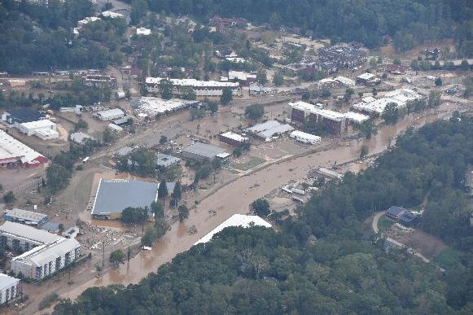
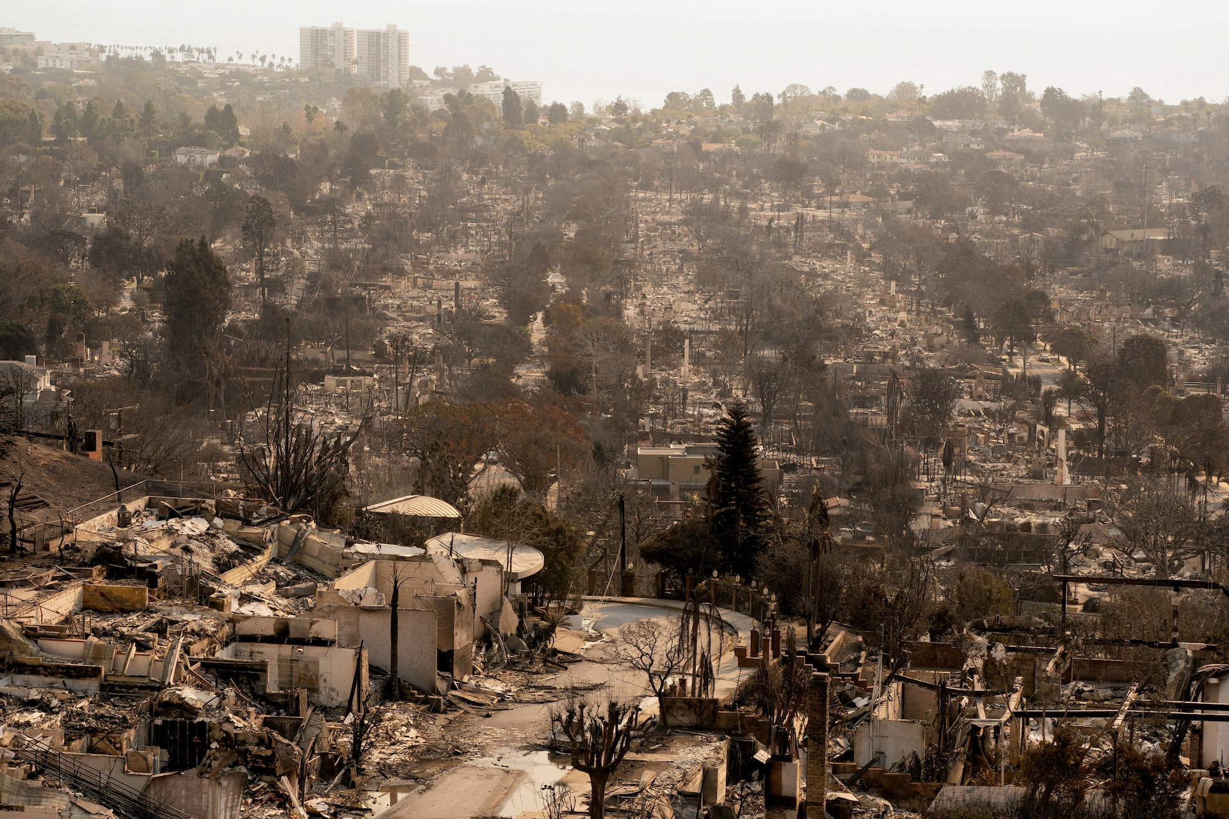
The new normal?
Pacific Palisades neighborhood, West Los Angeles, CA, January 2025
Asheville, NC, post-Hurricane Helene, October 2024
Photo credit: NC Dept of Transportation
Photo credit: David Ryder, Reuters
Notes:
“new” normal because (1) hurricane 400 miles from coast and (2) wildfires in January (far outside fire season).
Helene damage estimates (NOAA NCEI) = $78.7 billion, 7th costliest in history (Katrina still highest at 201 billion; Harvey 160 billion). Deaths in Helene second only to Katrina in continental US (1,392 in Katrina; 230 in Helene – roughly ½ in North Carolina). Costs of wildfires still being tallied but property damages alone roughly $80-90 billion and total costs are usually 2-3 times direct damages.
What is so unusual here? Locations, time of year. Appalachia experiences a hurricane. Wildfires in January and damaging heavily populated areas.

Slide 3
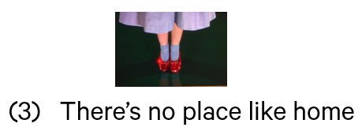
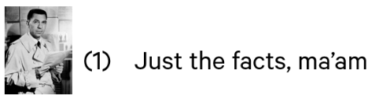

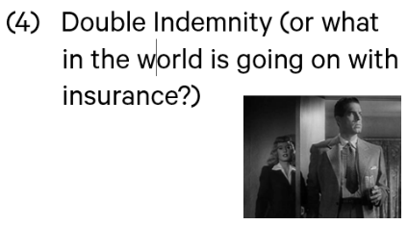
Outline of talk

Slide 4
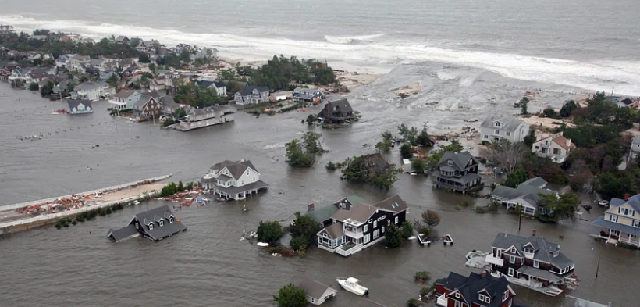
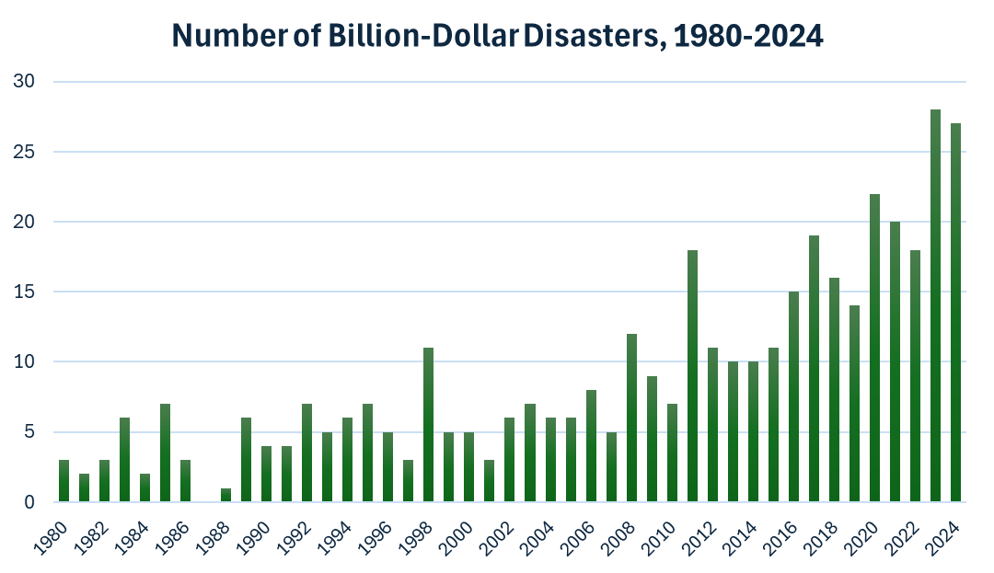
(1) Just the facts
Data source: NOAA

Slide 5
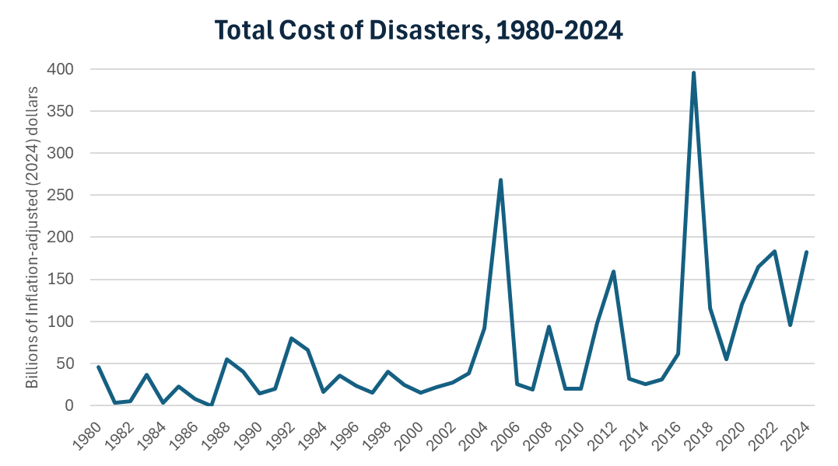
(1) Just the facts
Hurricanes Harvey, Irma, & Maria
Hurricanes Katrina & Rita
Data source: NOAA
Notes:
Katrina still costliest hurricane on record at over $200 billion (infl-adj). Helene damage estimates (NOAA NCEI) = $78.7 billion; Milton = $34.3 billion. Deaths in Helene (221) second only to Maria and Katrina (1,392 in Katrina; 3059 in Maria). Costs of Harvey = $125 billion.

Slide 6
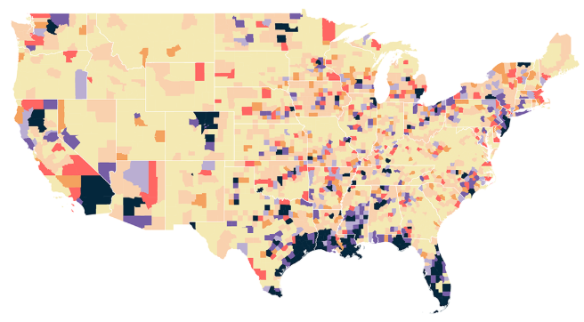
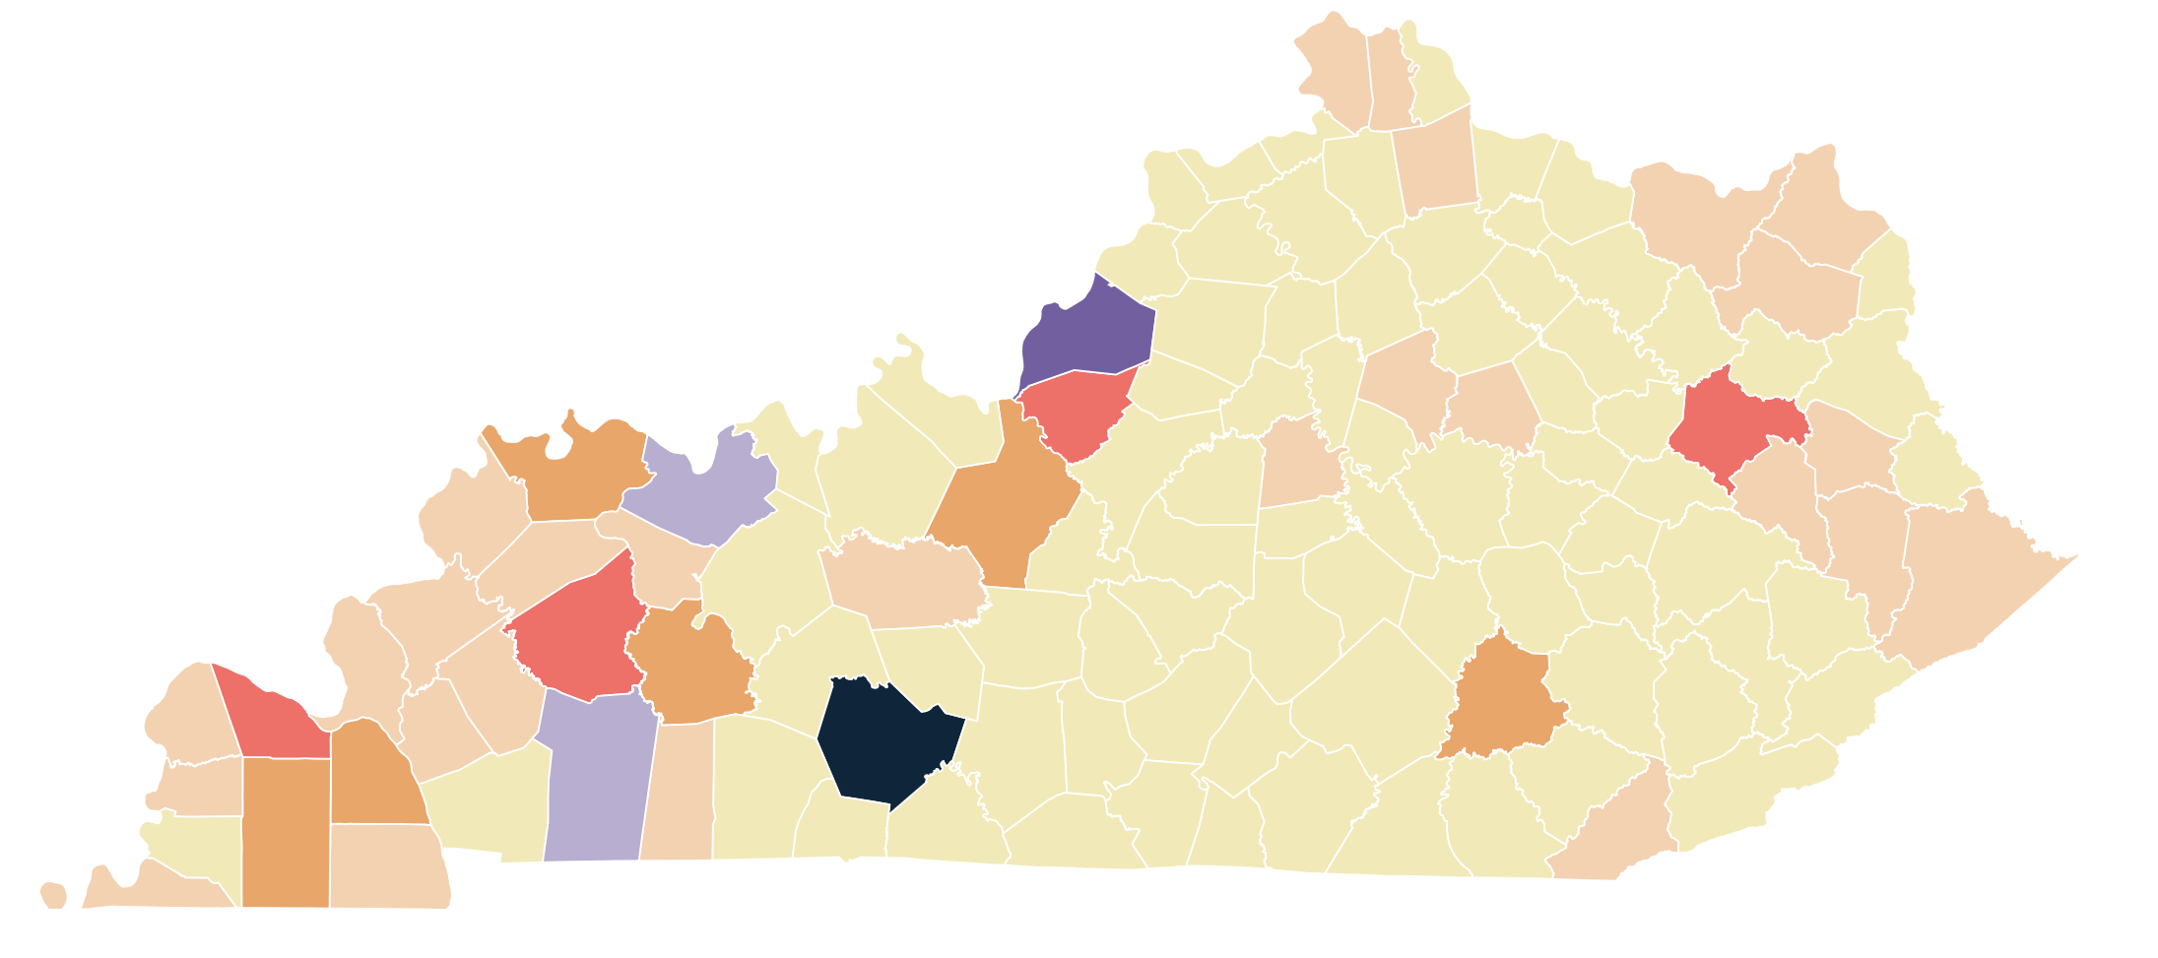
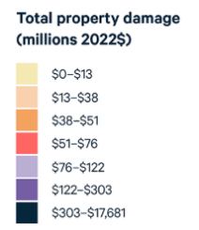
Just the facts
Property damage from extreme weather events by county, 1995-2022
Data source: RFF database created from NOAA data. See Walls et al. (2024).
Notes:
Reminder: these are direct property damage numbers only; not indirect, e.g. business interruption costs, which can make total costs 3X higher.

Slide 7
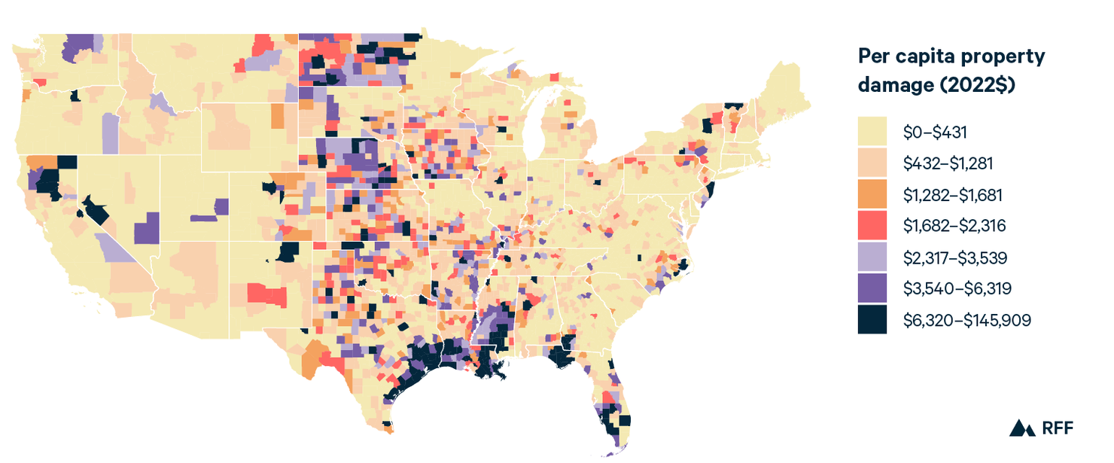
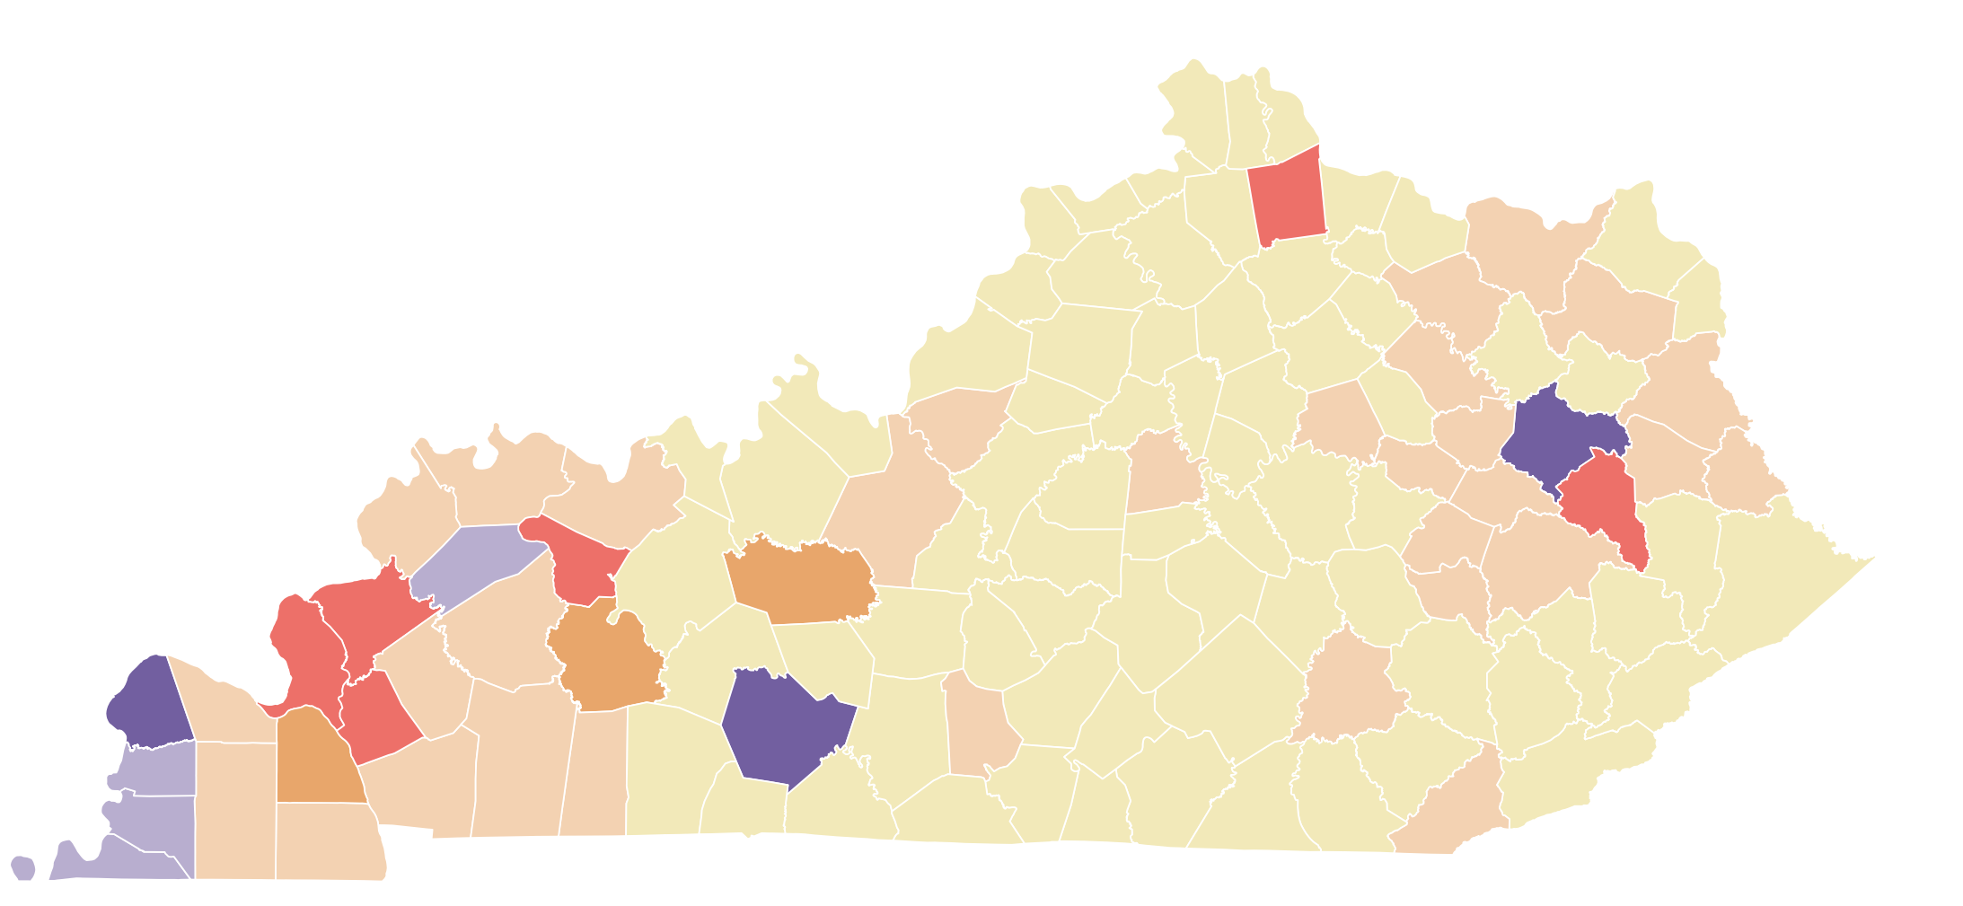
Just the facts
Per capita property damage from extreme weather events by county, 1995-2022
Data source: RFF database created from NOAA data. See Walls et al. (2024).
Notes:
Reminder: these are direct property damage numbers only; not indirect, e.g. business interruption costs, which can make total costs 3X higher.

Slide 8
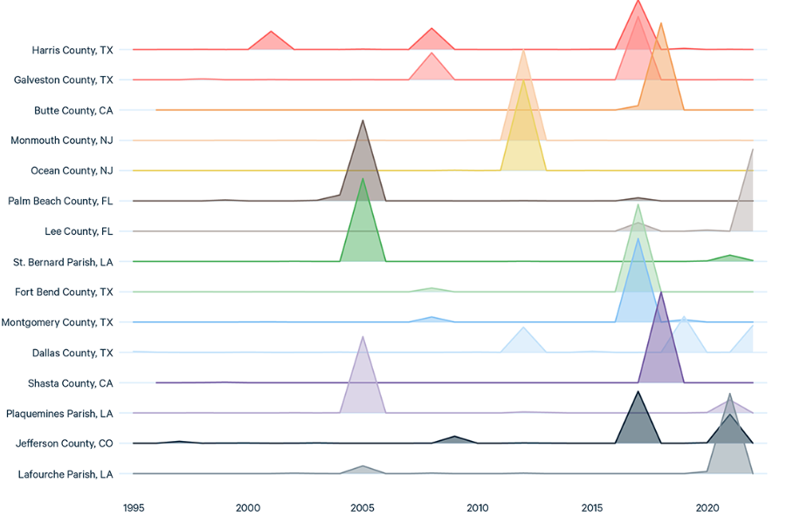
(1) Just the facts
Top 15 counties in property damage: losses by year
A single event can cause a large amount of damage
And place a county high up on the list
Notes:
Only 212000 people live in Butte County. Chico. Paradise, where Camp Fire hit in 2018.

Slide 9
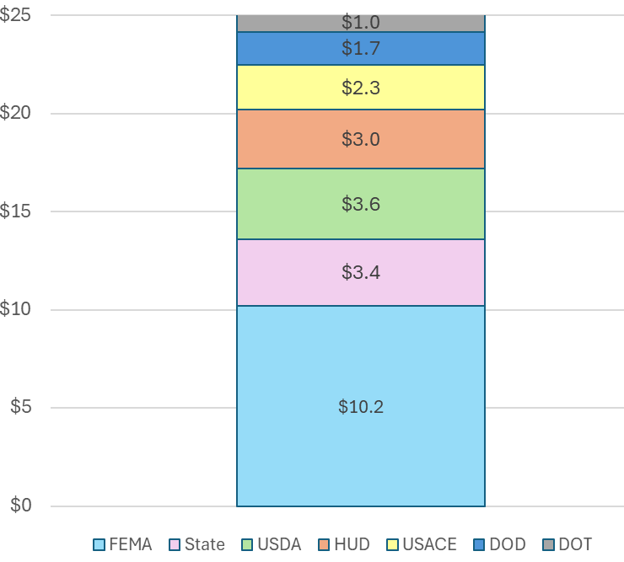
(2) Show me the money
Average annual spending on disaster recovery, 1992-2024 (in billions)
In years with big disasters, we spend a lot more
  FY2005 (Hurricanes Katrina & Rita) = $94 billion
  FY2018 (Hurricanes Harvey, Irma, Maria) = $47 billion
2022 Disaster in Eastern Ky: $738 million in FEMA & HUD funding
Notes:
This is the average over 33 years, $25 billion. But some years we spend far more. Supplemental appropriations in years with big disasters

Slide 10
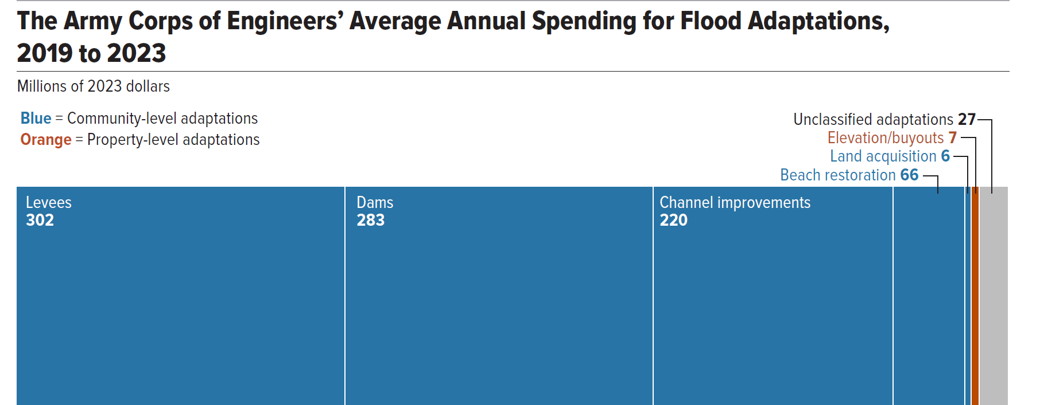
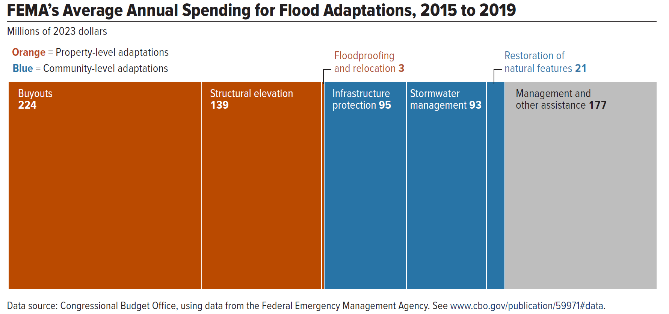
(2) Show me the money
Average annual spending on flood resilience, 2019-2023
We spend a lot less money on pre-disaster resilience than post-disaster recovery
Total = $911 million
Total = $752 million
Source: CBO (2024)
Notes:
$1.66 billion in total (this doesn’t count wildfire). But this was during a period that prioritized spending on these things. These numbers are down to basically zero now

Slide 11
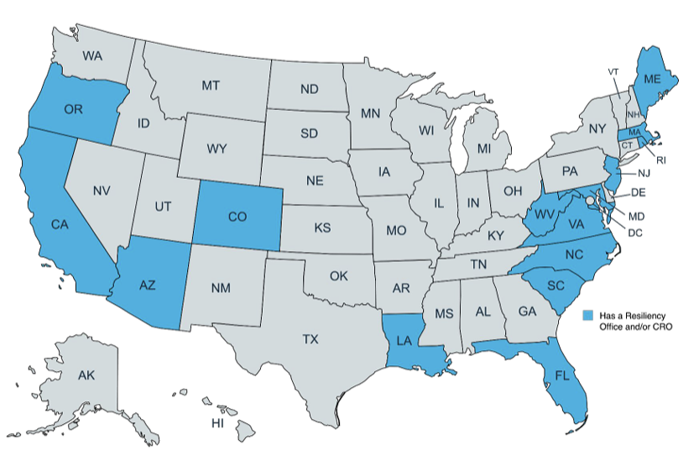
(2) Show me the money
What are states doing?
  15 states have Offices of Resilience and/or a Chief Resilience Officer
  Kentucky?
    No but legislature created a task force
    Nov. 2025 report recommended establishing a state office
      Work in phases
      First step: focus on data for tracking, mapping, etc
      Continue work of the task force
Source: American Flood Coalition (2025)

Slide 12
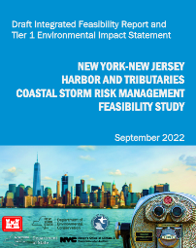
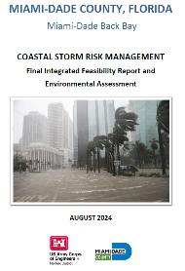
(2) Show me the money
Building resilience is essential for lowering disaster costs
  But so far, it’s mostly planning and not action
  Infrastructure projects are expensive and often controversial…
    New York City: Big waterfront project = $52 billion
    Miami: 6-mile long, 20-foot high sea wall = $6 billion
    Norfolk, VA: floodwalls, levees, tide gates, etc = $3 billion
  Where will the money come from?
    Especially challenging for small communities

Slide 13
The components of disaster risk
Disaster Risk = [Hazard] x [Exposure] x [Vulnerability]
Probability of an event that can cause harm
Propensity of people and property to suffer damage
Number of people/value of property in harm’s way
What can we do about this part of the problem, i.e., where should we be living?

Slide 14
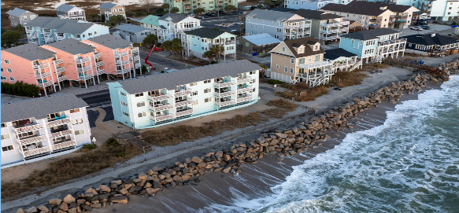
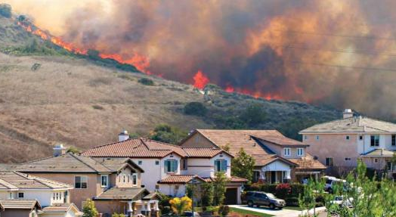
(3) There’s no place like home
We like to live in risky places!
13% of US population (41 million people) lives in the 100-year floodplain (Wing et al. 2018)
Number of homes in the wildland-urban interface (WUI) increased 47% between 1990 and 2020 (Mockrin et al. 2023)
2018-2022: 0.9 million new homes built in areas with highest weather-related risks—about 10% of all new homes (US Treasury 2025)

Slide 15
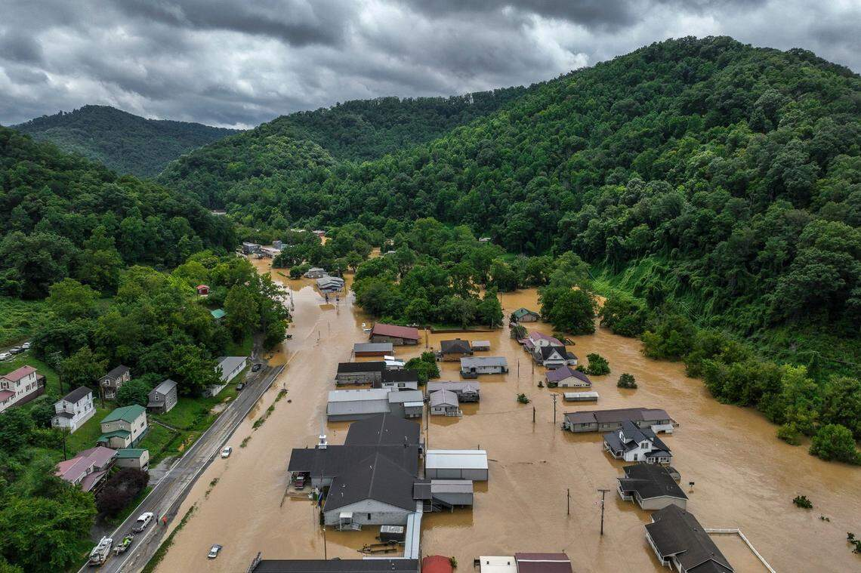
(3) There’s no place like home
What about places with challenging topography like Appalachia?
  Flood risks loom large but there are very few places where people can put houses, roads and other infrastructure
  As weather warms, extreme rain events are becoming more common
Garrett, KY. Photo credit: Ryan Hermens, Lexington Herald-Leader

Slide 16
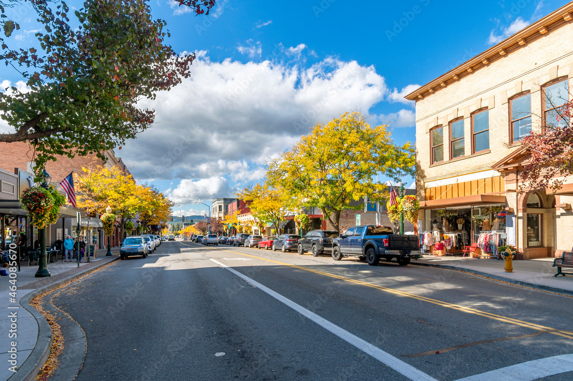
(3) There’s no place like home
What options do we have to lower risk exposure?
  Prices (e.g. mortgages, insurance)
  Property buyouts
  Zoning and land use regulations (do something before the land is developed)
  Indirectly… disaster aid policy; infrastructure spending
    Example… the Coastal Barrier Resources System
This is probably the most challenging part of the risk reduction equation
  Attachment to community
  Maintaining local property tax base

Slide 17
(4) Our fragile insurance markets
Insurance is critical for recovery after a disaster
  But homeowners insurance markets are having problems, especially in high-risk states (e.g. CA, FL, LA)
    High rates of insurer-initiated nonrenewals of policies
    Rate increases
    Coverage limits
    Insurers exiting the state altogether (especially in CA)
    Insurer bankruptcies (especially in FL)
    Homeowners increasingly relying on residual markets (“insurance of last resort” e.g., CA FAIR Plan, FL Citizens)
  Flood insurance is separate from homeowners
    Take-up rates are low
Notes:
Also called residual market.

Slide 18
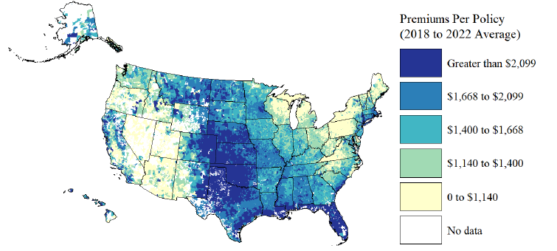
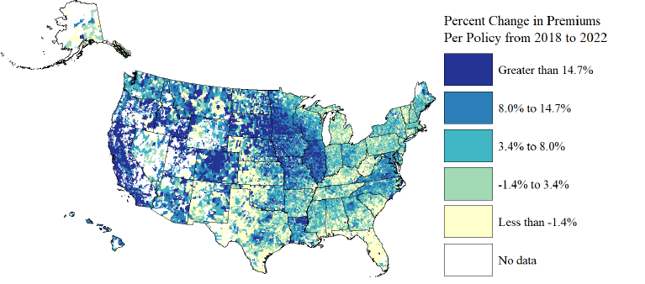
(4) Our fragile insurance markets
Average homeowners insurance premium
Average increase in premiums, 2018-2022
Source: US Treasury (2025)

Slide 19
(4) Our fragile insurance markets
Residual markets (“insurance of last resort”)
  California FAIR Plan = $723.6 billion in exposure
    668,609 policies in force, mostly in high wildfire risk areas
  Florida Citizens = $128.5 billion in exposure
    395,337 policies in force, mostly in high-risk coastal areas
  Florida also has a state-financed reinsurance fund ($3.3 trillion in exposure)
What’s wrong with all this?
  Residual market policies provide limited coverage for relatively high cost
  They rely on ex-post financing for severe loss years; assessments on admitted insurers, which are passed on to policyholders
Notes:
FL Citizens is a Nonprofit gov’t-run insurance provider
CA FAIR Plan is a pool supported by insurers in the admitted market
Residual markets rely on ex-post financing for severe loss years. This relies on cross-subsidies from low-risk aeas and future years to cover losses in current years. they issue debt and assessments are made on admitted insurers in the states, passed on to policyholders. In FL, it’s paid by policyholders in the first place

Slide 20
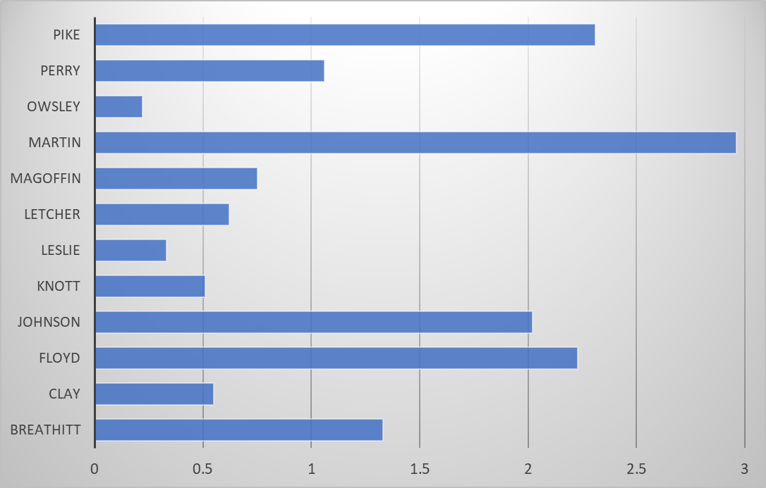
(4) Our fragile insurance markets
Percent of housing units in Eastern Kentucky counties with an NFIP Policy, 2022
What about flood insurance?
  FEMA’s National Flood Insurance Program (NFIP) provides majority of policies; small private mkt
  Purchase is voluntary
    Except for homes in the floodplain with federally-backed mortgages
  Take-up rates are very low
    FEMA’s recent move to stop subsidizing rates (Risk Rating 2.0) has exacerbated the problem
Source: Walls et al. (2022)
Notes:
Borrowing authority is $32.425 billion. Borrowed after Katrina, Sandy and Harvey. Helene
11–39% decline in new NFIP policies and a 5–13% drop in renewals after RR2.0 (Gourevitch et al 2025)

Slide 21
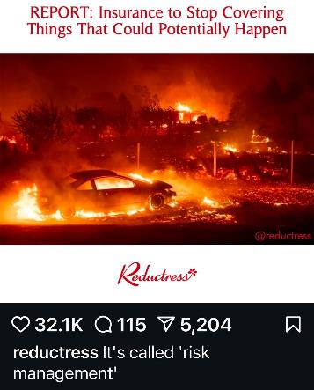
(4) Our fragile insurance markets
We have 2 problems to address:
  Insurability… we need private homeowners insurance markets to function well
    But this is increasingly difficult as number and severity of events are on the rise
    Correlated risks are challenging
  Flood insurance take-up… we need more people to have flood insurance

Slide 22
Conclusions
Federal leadership in 2026
  on resilience… don’t count on it
  on disaster recovery… less money, less capacity, more changes in the works (FEMA Review Council recommendations)
States:
  on resilience… progress is slow and uneven across states
  on disaster recovery… it remains to be seen
Notes:
Grist article headline: “FEMA’s Terrible Horrible No Good Very Bad Year”. Review council… disaster aid based on weather conditions, not financial damages; 50% staff cut (on top of 20% drop in 2025), move out of DC, encourage private flood insurance

Slide 23
Conclusions
States stepping up on resilience… my views:
  Plans are fine, a necessary first step, but must work on implementation
  Use levers/incentives to spur localities to action, e.g.
    Hazard Mitigation Plans
    Model zoning ordinances; Comprehensive Plan requirements
    Creative financing arrangements with local govt (e.g., revolving loan program)
  Where will the money come from?
    Get creative!
    Be prepared to make hard choices

Slide 24
Conclusions
My views (cont.)…
  Keep an eye on insurance markets
    State regulators need to not let markets reach a crisis point
    Recognize the challenges with correlated risks and increasing numbers of events
    Use insurance to incentivize adaptation
      discounts for FORTIFIED roofs, etc
      discounts for community actions
      but need to make these options work better
    New approaches? Parametric insurance, community insurance
      Check out Insurance for Good resources and ideas

Slide 25


Thank you
Questions, comments: walls@rff.org
Find out more about RFF: www.rff.org
And about RFF’s Climate Risks and Resilience Program: https://www.rff.org/topics/climate-risks-and-resilience/
  Additional (easy) readings and podcasts on these issues

